Slide 1
Estate Planning for Foreign Nationals–A World of Opportunity
OLA 2026 0315

Slide 2


Key Trends
Glocalization
Notes:
The economy is integrating. The world is coming to your doorstep.

Slide 3

Why Consider the Foreign National Market?
Large, growing population
Foreign Nationals face unique
U.S. planning challenges
Significant need for
information on strategies
and planning
Notes:
This segment is growing faster than the population generally and is more affluent as well. Think of employees of multinational corporations stationed here…physicians and medical professionals…academics and graduate students…and purchasers of vacation properties.

Slide 4
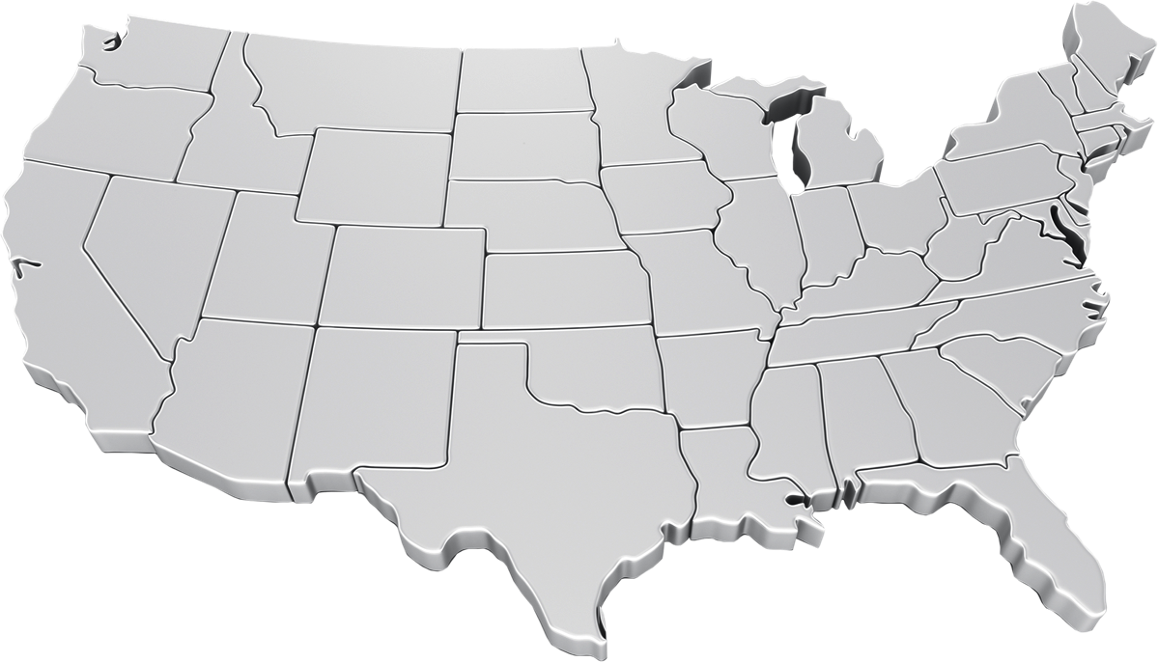
Where are Foreign Nationals?
Seattle
Boston
Minneapolis
Sacramento
Philadelphia
New York
Denver
Detroit
Las Vegas
Colorado Springs
Washington, DC
Los Angeles
Phoenix
Atlanta
Dallas – Fort Worth
Orlando
Tampa
West Palm
Beach
Houston
Sarasota
Miami
Notes:
Some producers may think that the growth of the foreign-born population is limited to traditional U.S. gateway cities like Los Angeles, New York or Miami. And while there are certainly regions that have a high concentration of foreign national residents, foreign nationals are not confined to these areas.
For instance 14% of the population in Boston and 21% in Las Vegas is Foreign Born.*
Where are Foreign Nationals?
Military Bases, Hospitals, Universities, Research firms, Corporate headquarters of multinational companies, US Branch Offices of Foreign Companies, Technology Companies
Consider:
BMW in Spartanburg, SC
Kyocera America, Inc., San Diego, CA
Canon USA, Inc, Melville, NY
So, if you live in a major city, chances are that there is a growing foreign national market in your area that is underserved.
*Geoscape national DMA report 2013
The foreign-born population includes anyone who was not a U.S. citizen or a U.S. national at birth.
This includes respondents who indicated they were a U.S. citizen by naturalization or not a U.S. citizen.
(U.S. Census Bureau, American Community Survey 2007 Subject Definitions).

Slide 5

Understanding Needs
Foreign Nationals fall into
two categories:
Resident Aliens
Non-Resident Aliens
Notes:
In order to get a clearer picture of the ideal foreign national candidate, it is important to understand generally how foreign nationals are classified and how they are taxed in comparison to U.S. citizens. Foreign Nationals are classified depending on where they have made their permanent home.

Slide 6

Resident Aliens
Foreign National with permanent U.S. home
Worldwide assets subject
to U.S. estate and gift tax
Denied certain tax
advantages available
to U.S. citizens
Notes:
Foreign Nationals who live in the U.S. with no present intention of leaving are “resident aliens” for transfer tax purposes and are taxed similar to a U.S. citizen. In other words, their worldwide assets will be subject to U.S. estate and gift tax. However, as we’ll discuss later in further detail, Resident Aliens are subject to some different tax rules than U.S. citizens. Therefore, they have unique planning needs.

Slide 7
Non-Resident Aliens
Foreign National with permanent home
in another country
Only U.S. assets subject
to U.S. estate
and gift tax
Notes:
Foreign Nationals who live permanently in another country will only be subject to U.S. estate and gift tax to the extent that they own assets that are considered located in the U.S.

Slide 8

Residency Factors
What is your
immigration status?
Where do you spend
most of your time?
Where do you consider
home to be?
Do you own a home
in the United States?
Notes:
Considering the fact that Foreign Nationals are taxed differently depending on their residency status, it’s important to determine whether these prospects can be classified as a Resident Alien or Non-Resident Alien. You might consider asking the following questions in an effort to determine where they have made their permanent home:
Are you and your spouse U.S. citizens?
Do you own a home in the U.S.? Do you own a home in another country?
How much time do you spend in this country versus that country?
Where are your friends and family located?
What is your immigration status? Green card or Visa?
Where do you plan to retire?

Slide 9

Planning Issues
Resident Aliens
with significant
worldwide assets
Non-Resident Aliens
with U.S.-based assets
Married couples
with a Foreign
National spouse
Notes:
Ideal candidates for foreign national estate planning include Non-Resident Aliens with significant U.S.-based assets and married couples consisting of at least one foreign national (Resident and/or Non-Resident Aliens).
Once you have learned to differentiate between Resident Aliens and Non-Resident Aliens, thereby determining applicable U.S. tax treatment, you will be better poised to identify life sale opportunities in the foreign national market. For now, we will focus on how life insurance can be a solution to the challenges facing: (1) Non-Resident Aliens owning U.S. real estate outright; and (2) married couples consisting of at least one foreign national.

Slide 10
U.S. Estate Tax Comparison
 | Resident Alien (RA) | Non-Resident Alien (NRA)
Estate tax exemption | $5,430,000 | $60,000
Estate tax rate | 40% top tax rate | Minimum 24% / Maximum 40% tax rate
Unlimited marital deduction | Only if inherited assets are transferred to QDOT* | Only if inherited assets are transferred to QDOT*
Assets subject to U.S. estate taxes | All worldwide assets | U.S. properties, including certain intangible properties**
*Only if inherited assets are transferred to a U.S. citizen spouse or to a QDOT.
**Intangible property includes stock in a U.S. corporation and interest in a U.S. partnership
Notes:
So, to summarize, Resident Aliens and Non-Resident Aliens are treated differently under the U.S. tax code—creating life insurance sale opportunities. Generally, only a Non-Resident Alien’s assets that are considered located in the U.S. will be subject to federal estate tax and they only get to shelter $60,000 from U.S. estate tax. In other words, Non-Resident Aliens with substantial U.S.-based assets face significant estate tax liability on transfers of this property upon death. Life insurance can be a viable option to provide the liquidity necessary to pay this estate tax bill.
In addition, you’ll notice that in order for the U.S. to ensure taxation of assets inherited by a foreign national surviving spouse, neither a Resident Alien nor a Non-Resident Alien is entitled to the unlimited marital deduction. In other words, the surviving spouse has to be a U.S. citizen in order to take advantage of this deduction and defer payment of estate taxes until the death of the survivor. In order to obtain a somewhat similar benefit, foreign nationals who inherit assets from their U.S. citizen spouses must transfer those assets to a special trust called a Qualified Domestic Trust or QDOT. QDOT requirements are numerous and inflexible. Life insurance can complement QDOT planning, providing additional funds for a non-citizen surviving spouse.
**This material does not contemplate the impact of applicable state or foreign laws and regulations upon clients and prospects. Clients should consult with and rely on their own legal and/or tax advisor to determine the consequences, if any, of owning or receiving proceeds from a Transamerica policy.

Slide 11
Resident Aliens
Worldwide assets subject to U.S. estate tax
Property in the United States
Property outside the United States
Notes:
We have just covered the estate tax for Non-resident aliens on U.S. situs assets which starts after $60,000 in value. Unlike non-residents, resident aliens are taxed on their worldwide assets. They have the same estate tax exemption amount as U.S. citizens, $5.43 million in 2015, indexed for inflation.

Slide 12
What they don’t know…
A survey of immigrants to the U.S. with
a net worth of $10 million or more found:
Survey Question Asked | % Who Answered Yes
Before emigrating to the U.S. those who sought advice as to the consequences of acquiring a U.S. residency for U.S. gift and estate taxes | 34.5%
Obtained advice for making gifts of non-U.S. property prior to coming to the U.S. | 10.9%
After emigrating to the U.S., those who sought tax advice | 49.6%
Of the above group, those who sought advice on U.S. estate planning that could minimize estate taxes | 6.8%
Source: “Clueless,” Trusts and Estates, December 2003

Slide 13

Why Is Planning Important?
Meet Carlos, a Peruvian national,
U.S. resident
$15 million in U.S. assets
$20 million in Peruvian assets

Slide 14
Estate Erosion
Gross Estate | $35,000,000
Estate Tax | $11,845,800
Net Estate | $23,154,200
Estate Shrinkage | 33.85%

Slide 15
Solution: Trust owned life insurance
Create irrevocable life insurance trust
Trust provides liquidity for estate taxes and other needs

Slide 16
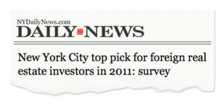
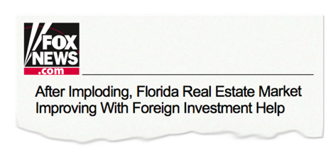
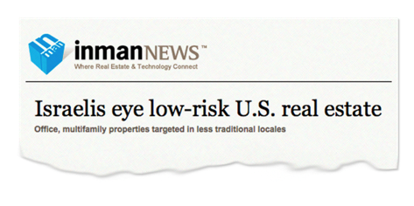

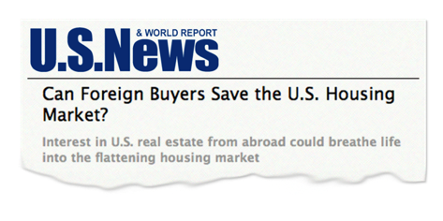

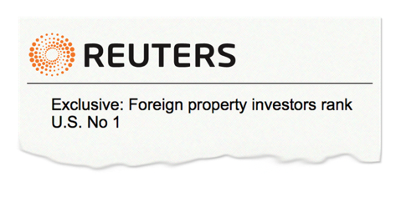
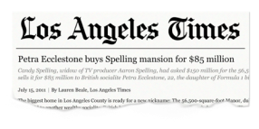




Non-Residents
Purchasing U.S. Real Estate
Notes:
Miami residences…New York pied-a-terre…California getaways…moving the family to Texas while managing a business in Central America

Slide 17


What They Don’t Know
Resident Alien
Non-Resident Alien
$5.43M
$60,000
Notes:
They may not know that, unlike a U.S. citizen and Resident Alien, who can shelter property worth $5.43M from U.S. estate tax, a Non-Resident Alien is only able to shelter $60,000 from U.S. estate tax.

Slide 18

Why Planning Is Important
Niran
Thai resident and national
Purchased ski getaway
in Colorado
Notes:
To illustrate the problem that Non-Resident Aliens may face, consider the case of Niran, a non-U.S. citizen and Thai resident. On his last trip to the United States, he bought a $3 million property in Telluride, Colorado, which he visits once a year.

Slide 19



U.S. Estate Tax Exposure
$3M
home in Telluride, CO
estate tax liability in 2015
$1.1M
Notes:
Unfortunately, what no one explained to Niran was that by buying this property and owning it outright, he was creating a U.S. taxable estate. If he were to die in 2014, when the U.S. estate tax rate is 40%, his estate would owe over $1 million in U.S. estate taxes.

Slide 20
Nonresident Aliens
U.S. Gift and Estate Situs Rules
Type of property transferred | Subject to U.S. Gift tax | Subject to U.S. Estate tax
Real property located in U.S. | Yes | Yes
U.S. tangible personal property (i.e., cash, jewelry, paintings, automobiles) | Yes | Yes
U.S. intangible personal property (i.e., stocks in U.S. corp., interest in U.S. partnership) | No | Yes
Ownership interest in a U.S. life insurance policy on oneself | No* | No
*A gift of a life insurance policy on oneself may be subject to the IRC §2035 look back rule, and therefore may be subject to estate taxes if included
within the decedent’s estate.

Slide 21
Estate Erosion
Death in 2015
Tentative Tax Less Credit | ($1,145,800) $13,000
Net Taxes | ($1,132,800)
Net U.S. Assets | $1,867,200
Estate Erosion = 38%
Notes:
In other words, U.S. estate tax will erode Niran’s estate by 38% in 2015.

Slide 22


Alternative 1
Tangible Property
Intangible Property
Gift to Heirs
Notes:
Let’s look at alternative 1:
Change tangible property to intangible property
Gift intangible property during life to heirs
No estate tax, no gift tax
BUT lose control

Slide 23




Alternative 2
Notes:
This problem of US estate taxes is often addressed by setting up extremely complex estate and business planning strategies. Specifically, foreign nationals employ attorneys to engage in multiple jurisdiction entity structuring, which essentially consists of layering. To illustrate this concept, consider Russian nesting dolls, the hollow wooden dolls of decreasing size that are placed one inside the other. However, instead of wooden dolls, attorneys layer various entities. For example, you may see a foreign trust, which is in turn a major partner in a foreign partnership, which is in turn a major partner in a U.S. partnership, which in turn owns a foreign national’s U.S. real estate.
This solution can be quite costly, requiring a substantial initial fee as well as ongoing administrative expenses for each entity. Furthermore, some structures are more aggressive than others, falling under a gray area in the law. In other words, in some cases there is a question as to whether this elaborate planning will in fact shelter U.S. assets from U.S. estate tax. This structure can also create U.S. income tax from imputed rent. G.D. Parker, Inc. v. CIR, TC Memo 2012-326

Slide 24


Alternative 2
Notes:
This problem of US estate taxes is often addressed by setting up extremely complex estate and business planning strategies. Specifically, foreign nationals employ attorneys to engage in multiple jurisdiction entity structuring, which essentially consists of layering. To illustrate this concept, consider Russian nesting dolls, the hollow wooden dolls of decreasing size that are placed one inside the other. However, instead of wooden dolls, attorneys layer various entities. For example, you may see a foreign trust, which is in turn a major partner in a foreign partnership, which is in turn a major partner in a U.S. partnership, which in turn owns a foreign national’s U.S. real estate.
This solution can be quite costly, requiring a substantial initial fee as well as ongoing administrative expenses for each entity. Furthermore, some structures are more aggressive than others, falling under a gray area in the law. In other words, in some cases there is a question as to whether this elaborate planning will in fact shelter U.S. assets from U.S. estate tax. This structure can also create U.S. income tax from imputed rent. G.D. Parker, Inc. v. CIR, TC Memo 2012-326

Slide 25


Alternative 2
Notes:
This problem of US estate taxes is often addressed by setting up extremely complex estate and business planning strategies. Specifically, foreign nationals employ attorneys to engage in multiple jurisdiction entity structuring, which essentially consists of layering. To illustrate this concept, consider Russian nesting dolls, the hollow wooden dolls of decreasing size that are placed one inside the other. However, instead of wooden dolls, attorneys layer various entities. For example, you may see a foreign trust, which is in turn a major partner in a foreign partnership, which is in turn a major partner in a U.S. partnership, which in turn owns a foreign national’s U.S. real estate.
This solution can be quite costly, requiring a substantial initial fee as well as ongoing administrative expenses for each entity. Furthermore, some structures are more aggressive than others, falling under a gray area in the law. In other words, in some cases there is a question as to whether this elaborate planning will in fact shelter U.S. assets from U.S. estate tax. This structure can also create U.S. income tax from imputed rent. G.D. Parker, Inc. v. CIR, TC Memo 2012-326

Slide 26

Alternative 2
Notes:
This problem of US estate taxes is often addressed by setting up extremely complex estate and business planning strategies. Specifically, foreign nationals employ attorneys to engage in multiple jurisdiction entity structuring, which essentially consists of layering. To illustrate this concept, consider Russian nesting dolls, the hollow wooden dolls of decreasing size that are placed one inside the other. However, instead of wooden dolls, attorneys layer various entities. For example, you may see a foreign trust, which is in turn a major partner in a foreign partnership, which is in turn a major partner in a U.S. partnership, which in turn owns a foreign national’s U.S. real estate.
This solution can be quite costly, requiring a substantial initial fee as well as ongoing administrative expenses for each entity. Furthermore, some structures are more aggressive than others, falling under a gray area in the law. In other words, in some cases there is a question as to whether this elaborate planning will in fact shelter U.S. assets from U.S. estate tax. This structure can also create U.S. income tax from imputed rent. G.D. Parker, Inc. v. CIR, TC Memo 2012-326

Slide 27

Alternative 3
Life Insurance
Notes:
Don’t restructure the problem, solve the problem. To mitigate his potential liability, Niran can provide his estate with the liquidity necessary to pay this tax bill by buying a life insurance policy for $1.5 million. By doing this, Niran can ensure that his loved ones will inherit all—and not simply a fraction—of his U.S. property.
Premium payment structuring may also be simple, because a non-citizen/non-resident can own the policy insuring his own life and the death benefit will not be subject to U.S. estate taxes. In other words, it’s not necessary to set up a trust in order to shelter the death benefit from U.S. estate taxes. That means that a non-citizen/non-resident with a $10 million U.S.-based estate can buy a $5 million life insurance policy insuring his life—own it outright—and the value of his taxable U.S. estate will not jump to $15 million the way it would for a U.S. citizen or resident. Therefore, in some cases, life insurance truly may be the simplest solution for U.S. estate tax issues —since no trust means no need for attorneys, attorney’s fees, gifts to a trust, Crummey letters and administrative expenses.
Now, it should be noted that there may be other reasons why clients may consider other policy ownership options. It is important to keep in mind that in U.S. estate planning for foreign nationals, the laws of at least two countries must be considered—the laws of the U.S. and the laws of the proposed insured’s country of citizenship and perhaps even country of residence (if different). Some countries have restrictions which prohibit residents from owning policies outright. In addition, negative tax consequences may apply to individually owned life insurance policies or proceeds paid directly to foreign national beneficiaries.
The bottom line is this: life insurance is generally an elegant solution to the U.S. estate tax problem facing some foreign national investors in U.S. real estate. When you compare the simplicity of buying a life insurance policy to the complexity of multiple jurisdiction entity structuring, the sales pitch is easy.

Slide 28

Married Couple with Foreign National
No unlimited marital
estate deduction
Notes:
Real estate is not the only area where shifting demographics and an increasingly global marketplace present attractive sales opportunities in the foreign nationals market. Another sales opportunity centers on married couples consisting of at least one Foreign National.

Slide 29




Love knows no boundaries
ENGLAND / 33,877
GERMANY / 92,997
CANADA / 69,887
CHINA / 29,532
JAPAN / 28,964
ITALY / 19,080
CUBA / 14,430
SPAIN / 12,653
KOREA / 39,846
INDIA / 35,092
VIETNAM / 20,951
THAILAND / 13,368
PHILIPPINES / 74,180
MEXICO / 390,950
TOP COUNTRIES FOR CROSS-BORDER MARRIAGES TO A U.S. CITIZEN
(TOTAL NUMBER OF COUPLES IN 2010)
Source: "Legal Hassles of Global Love Affairs” Wall Street Journal, Summer 2013
Notes:
"Legal Hassles of Global Love Affairs" Wall Street Journal, Summer 2013

Slide 30



The Issue
U.S. Citizen
Foreign National
Notes:
One common problem that arises for wealthy, married foreign nationals is that foreign nationals are denied the unlimited marital deduction. The unlimited marital deduction is only available if the recipient is a married U.S. citizen; it allows them to make unlimited tax-free transfers to one another during life and upon death. Therefore, a married couple consisting of at least one foreign national that either fails to plan or relies on traditional estate planning may be subject to negative U.S. estate tax consequences.

Slide 31
The Issue
No Deduction
U.S. Citizen
Foreign National
Notes:
For example, consider the case of a U.S. citizen married to a foreign national:
If the U.S. citizen dies first in 2015, his half of their joint estate will be transferred to his wife and his estate may take advantage of the $5.43 million estate tax exemption. However, any U.S. estate taxes that may be due on assets in excess of the exemption will be due within 9 months of death because the non-citizen spouse is not eligible for the unlimited marital deduction absent proper planning.
Interestingly, the outcome if the foreign national dies first is different because money flowing to a U.S. citizen surviving spouse is eligible for the unlimited marital deduction. So, in that case the U.S. citizen would be able to defer payment of any U.S. estate taxes until his own death.

Slide 32
The Issue
U.S. Citizen
Foreign National
Notes:
Interestingly, the outcome if the foreign national dies first is different because money flowing to a U.S. citizen surviving spouse is eligible for the unlimited marital deduction.

Slide 33
The Issue
Unlimited Marital Deduction
U.S. Citizen
Foreign National
Notes:
So, in that case the U.S. citizen would be able to defer payment of any U.S. estate taxes until his own death.

Slide 34
Why Planning Is Important
Mark, a U.S. citizen
Anna, a Philippine citizen
and U.S. Resident Alien
$15 million net worth
Notes:
To illustrate the opportunities in this market, consider the case of Mark and Anna, a married couple. Mark is a U.S. citizen and Anna is a Philippine citizen and Resident Alien. They have a net worth of $15 million.

Slide 35


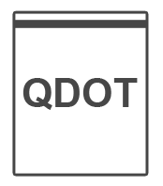


Alternative One: QDOT
$ $ $ $ $
$
$
$
U.S. Citizen
Resident Alien
Notes:
At Mark’s death, the unlimited marital deduction is not available to Mark’s estate for the benefit of Anna unless: (1) she becomes a citizen prior to the time for filing Mark’s federal estate tax return; or (2) their property is passed to a Qualified Domestic Trust (QDOT). In other words, no federal estate tax marital deduction is available when the surviving spouse is not a U.S. citizen, even if he or she is a U.S. resident, unless use is made of a QDOT.
There are two options when it comes to setting up a QDOT. The couple can set one up during life in their will or trust. Or, if the couple has done no planning, the surviving non-citizen spouse can simply set up a QDOT and irrevocably assign the property that she inherits from her U.S. citizen spouse to the QDOT within 9 months of his death.
Drawbacks of Planning with a QDOT
A QDOT may increase the total estate taxes due when the non-citizen spouse dies, since the assets are subject to estate tax in the first decedent spouse’s estate, and subsequent asset growth can increase this future liability. In short, the estate tax is not forgiven or reduced through the use of a QDOT, it is merely delayed. The calculation of estate taxes on the QDOT assets require the QDOT trustee to calculate the estate tax on the first decedent spouse’s estate with and without the QDOT property, subtracting the latter from the former. The difference represents the amount of tax owed from the QDOT upon any distribution or the death of the second spouse. The tax withheld is also considered a tax-triggering distribution. IRC § 2056A(b)(2)(A); Treas. Reg. § 20.2056A-6(a).
This may be partially avoided if the non-citizen spouse becomes a US citizen; see Treas.Reg. 20.2056A-10(b).
Furthermore, any distribution from a QDOT other than distributions of income and distributions of principal required because of “hardship” (as yet undefined by the Code or the Regulations) results in immediate imposition of U.S. estate tax on the trust. [1] A distribution of principal is made on account of hardship if the distribution is made in response to an immediate and substantial financial need relating to the spouse’s health, maintenance, education, or support or that of any person the surviving spouse is legally obligated to support. A distribution is not considered made on account of hardship if the amount distributed may be obtained from other sources that are reasonably available to the surviving spouse. Assets such as closely held business interests, real estate and tangible property are not considered sources that are reasonably available to the surviving spouse. Also, estate tax is payable when the QDOT requirements cease to be met. [2]
It should also be noted that property transferred to a QDOT is treated as passing from the decedent to the QDOT solely for the purpose of preserving the unlimited marital deduction for transfers to a non-citizen spouse. However, for all other purposes, the surviving spouse is treated as the transferor of the property to the QDOT. In other words, property passing to a QDOT that creates a vested remainder interest in children or grandchildren will result in gift tax liability for the surviving spouse based on the present value of the remainder interest. Furthermore, at the death of the surviving spouse, he or she will be treated as the transferor of the property into the trust for estate and generation skipping transfer tax purposes.
[1] IRC Secs. 2056A(b)(1)-2056A(b)(3).
[2] IRC Secs. 2056A(b)(1), 2056A(b)(4).

Slide 36
QDOT
No immediate estate taxation
Assets “stuck” in U.S.
Distributions limited to income and hardship
OR immediate estate taxation
Need U.S. trustee, may require bond

Slide 37

Alternative Two: Life Insurance
$ $ $ $ $
$
$
$
U.S. Citizen
Philippine Citizen
Resident Alien
Notes:
Life insurance is a simple alternative solution; it is a good way to ease the economic problems created by U.S. estate tax when one or both spouses is a foreign national. While foreign nationals are denied the unlimited marital deduction, they can take advantage of what is often referred to as the “super” annual exclusion to fund a legacy trust. A foreign national may receive an annual gift from his or her spouse up to $147,000 (indexed for inflation) on a U.S. gift tax-free basis. [1] These gifts can be used by the foreign national spouse to buy life insurance on the life of the U.S spouse. Best of all, the proceeds will be received by beneficiaries U.S. income and estate tax-free, assuming no incidents of ownership in the policy are held by the decedent at death.[2]
[1] Rev. Proc. 2014-61, Sec. 3.35(2).
[2] IRC Sec. 2042(2); IRC Sec. 101(a)(1).

Slide 38

Why Plan for Foreign Nationals?
Large, growing demographic
Special financial planning needs
Resident Aliens–
worldwide estate
Non-resident Aliens–
U.S. estate
No unlimited marital
estate deduction

Slide 39
Life Insurance
A simple solution
Internationally competitive

Slide 40

Next Steps
Review your book
of business
Reach out to contacts
that match the client profile
Strengthen and build
your referral network
Notes:
In conclusion, the foreign nationals market is broad, growing and largely underserved. Therefore, you may already have foreign nationals as clients. Review your current book of business and reach out to clients who may face the estate planning issues discussed in this presentation. But don’t stop there. Strengthen and build your referral network and seize this golden opportunity.

Slide 41

Look at your existing business
Immigrant clients?
Clients with
immigrant spouses?
Develop a
champion client
Notes:
Clearly, foreign nationals have unique estate planning needs based on their tax treatment under the U.S. tax code. Life insurance can be a critical part of a comprehensive estate plan for foreign national clients. Now, let’s talk about how you can tap into this market. It’s important to note that some producers are poised to do well in the foreign national market. Specifically, those producers who are perhaps immigrants themselves have an edge in this market. For example, an immigrant with deep roots in a U.S. immigrant community may have a built-in market for foreign national planning. Similarly, a producer’s ability to break down a language barrier with prospects will be a sales advantage. Some producers may not possess any of these attributes, but they may reside in a resort/vacation destination or some other location with high foreign national investment, such as California, Texas, Florida and New York. In that case, producers may connect with international investment associations—perhaps presenting a seminar to educate members about their unique planning needs. Furthermore, producers can build a reciprocal referral network with immigration and/or international tax attorneys.
**As always, producers must comply with Transamerica's solicitation rules and requirements.

Slide 42

Look at your neighborhood
Nearby colleges/universities?
Nearby hospitals?
Nearby military bases?
Talk to realty firms for leads
Align with immigration and/or
international tax attorneys and real estate agents catering to foreign national home sales
Network with ethnic business associations
Notes:
In addition, producers may consider mining international realty firms for leads—hosting seminars for real estate agents that cater to the foreign national market, educating them about U.S. estate planning pitfalls. Producers may arrange similar presentations for the members of ethnic business associations. Finally, producers can encourage existing clients to refer their friends and family members who require similar planning.

Slide 43
Why Transamerica?
Dedicated international underwriting team
  Established in 1998 – deep understanding of landscape
Access to experts & marketing materials:
  Attorneys and Certified Financial Planners providing consultative support and case design
  Chinese and Spanish language materials
Foreign Nationals Connection:
  Hub for information, sales ideas, and materials & forms
  Viewable across mobile, tablet, laptop, and desktop
Notes:
Transamerica is committed to the foreign national marketplace. Our resources are unrivaled in the industry.
Process Business Quickly with Dedicated Underwriting Team
We have a dedicated international underwriting team with a deep understanding of the nuances inherent in the global market and extensive experience in the large case market.
Access to Marketing Materials & Experts on Advanced Marketing Team
We also provide you access to marketing materials and to experts in the Advanced Marketing department, to provide technical guidance regarding the use and taxation of life insurance with respect to U.S. gift and estate planning strategies for foreign nationals.
Resources for you
Foreign Nationals Connection - a microsite with information and resources dedicated to the Foreign Nationals market opportunity. Works across mobile, tablet, laptop, and desktop platforms for the best viewing experience.

Slide 44

Why Transamerica?
iPad App
  Clear and engaging animations
Expand market
  Few product limitations
  Very competitive premiums
Close more business
  Best underwriting risk class
  generally available
Notes:
iPad App
New with version 5.0 will is a Foreign Nationals tab walking you through three simple steps with clear and engaging animations.
Increase Market with Broad Product Availability
All of our U.S. products, except Transamerica Journey VUL and Trendsetter LB are available to non-resident aliens.
Expand Market Reach with Low Minimum Face Amount Requirements
While Transamerica does impose low minimum face amount requirements for most products, these requirements are strictly product-specific—not market-specific—and are considerably lower than the minimum face amount requirements that many carriers impose on foreign national business.
Close More Sales with Competitive Premiums
Transamerica offers competitive premiums for most products and regions of the world. Unlike other carriers, Transamerica generally does not cap its premiums at Standard, offering clients the most competitive premiums for which they qualify.

Slide 45








Transamerica’s Available Resources
Foreign
Nationals Team
Marketing Tools
Support
Dedicated International Underwriting Team
Foreign National Connection web site
Contact
Advanced Marketing
(877) 238-6758
foreign.national@transamerica.com
Mike Thaxton, SVP, Global Link Solutions
Christopher Guerin, AVP,
International Underwriting
Claire Durand, Director, Advanced Marketing
John Oliver, VP,
Field Development
Notes:
To assist you with your conversations, Transamerica has a host of marketing tools and resources available to you. Everything from the new Foreign Nationals Connection microsite, iPad App, useful strategy summaries, to client fact finders, producer guides and 1-page sales ideas with sample cases.
And to connect the dots, Transamerica’s Advanced Marketing, International Underwriting, and Sales teams are here to support you to discuss specific cases and strategies for foreign national clients.
Contact us today at 1-877-238-6758 or foreign.national@transamerica.com

Slide 46
Transamerica Life Insurance Company and its agents and representatives do not give tax or legal advice. This material and the concepts presented here are for information purposes only and should not be construed as tax or legal advice. Any tax and/or legal advice you may require or rely on regarding this material should be based on your particular circumstances and should be obtained from an independent professional advisor.
Discussions of the various planning strategies and issues are based on our understanding of the applicable federal tax laws in effect at the time of presentation. However, tax laws are subject to interpretation and change, and there is no guarantee that the relevant tax authorities will accept Transamerica’s interpretations. Additionally, this material does not consider the impact of applicable state or foreign laws and regulations or income or estate tax treaties between the U.S. and other countries upon clients and prospects. Clients should consult with and rely on their own legal and/or tax advisor to determine the consequences, if any, of owning or receiving proceeds from a Transamerica policy.
Although care is taken in preparing this material and presenting it accurately, Transamerica disclaims any express or implied warranty as to the accuracy of any material contained herein and any liability with respect to it. This information is current as of March 2015.
OLA 2026 0315

